Slide 1
Preparing a Wet Mount Slide
02-09-16

Slide 2
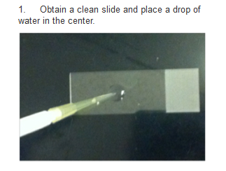
Step 1

Slide 3
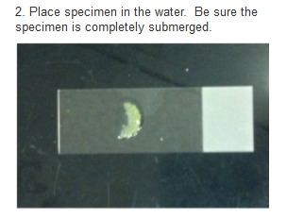
Step 2

Slide 4
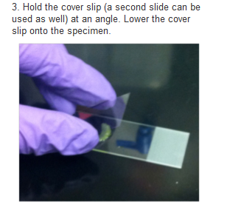
Step 3

Slide 5
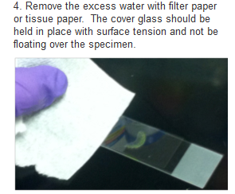
Step 4

Slide 6
Preparing a Wet Mount Slide You don’t need to write this!
When instructed…
Obtain a slide
Obtain a specimen (letters)
Obtain a paper towel
Obtain a cup with water and a pipette
Obtain a cover slip FROM ME
3. Follow steps 1 through 4
4. Wait for Ms. St. Louis to check your slide for a grade

