Slide 1
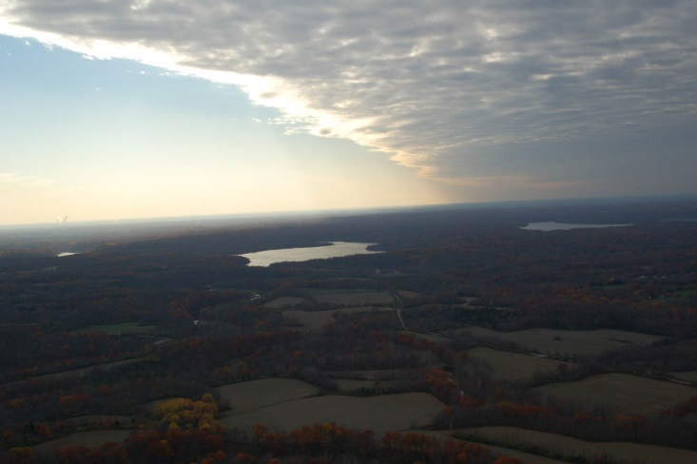
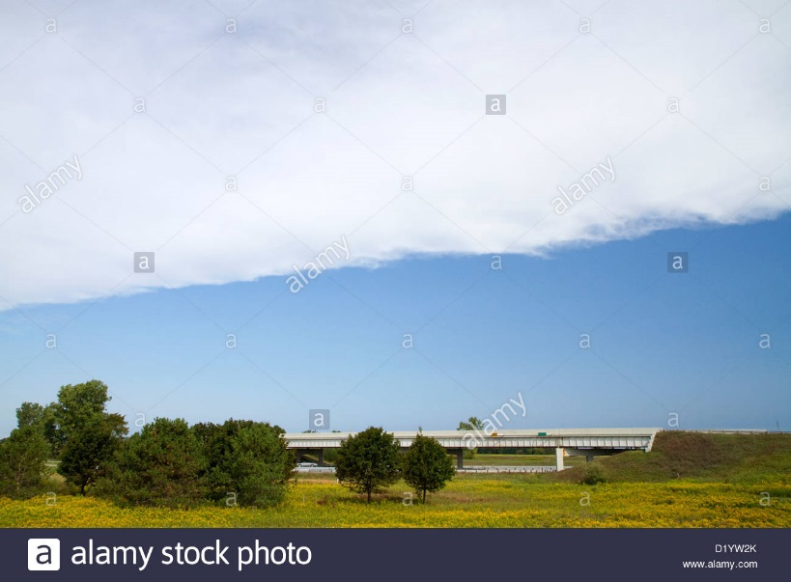
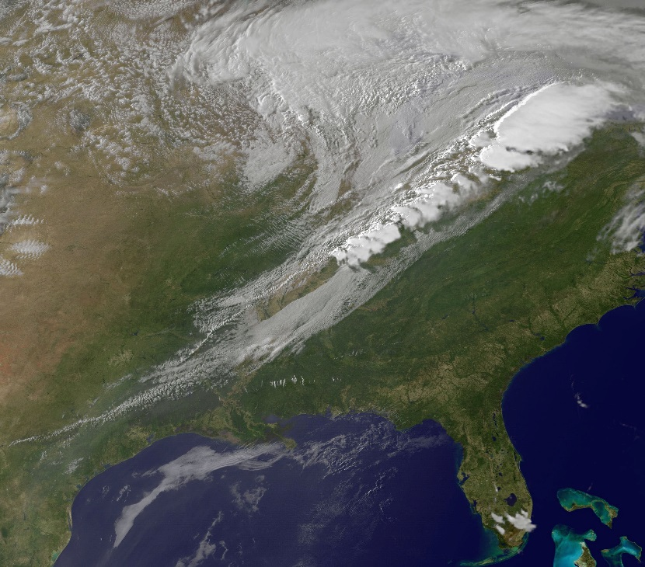
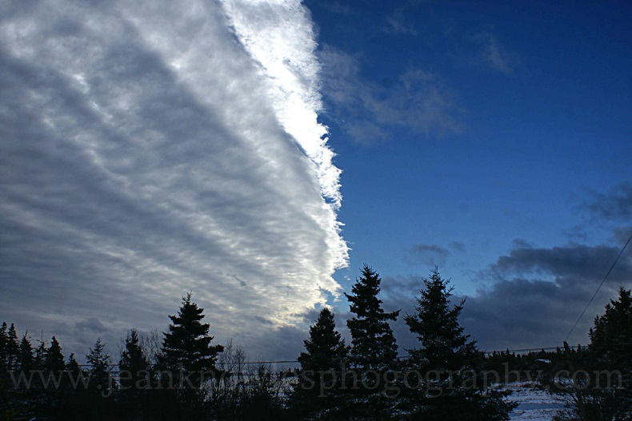
Monday 11/28
Look at the pictures. Explain what you think is happening. Write it down for today’s date (don’t need to write a question)

Slide 2
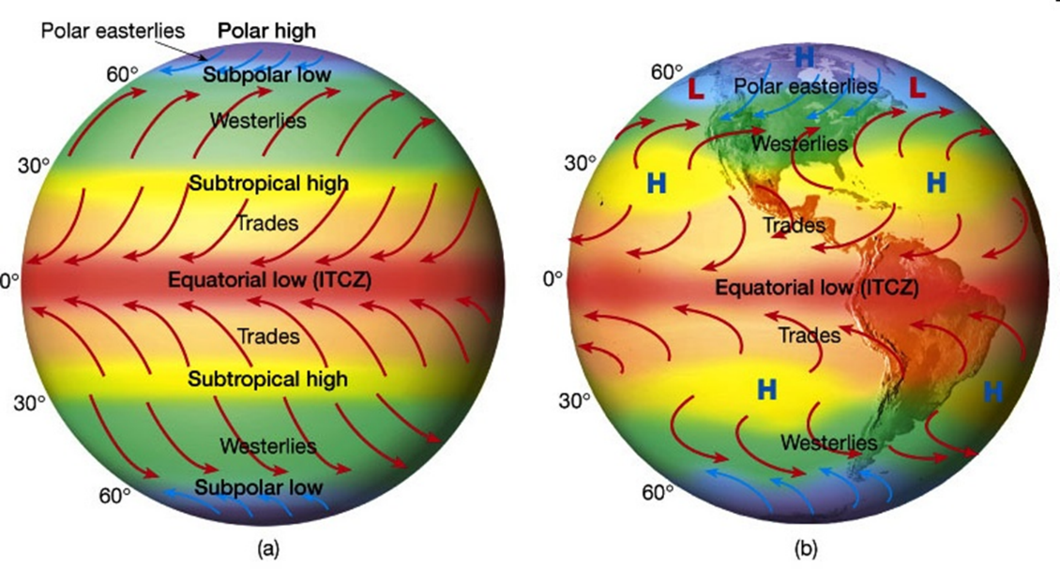
Tuesday 11/29
The very calm band of winds found at the equator is known as the __________________.

Slide 3
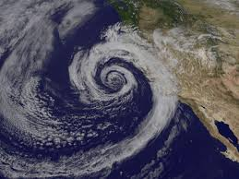
Wednesday 11/30
Using your hands—what are the wind patterns of a cyclone?
What are the wind patterns of an anticyclone?

Slide 4
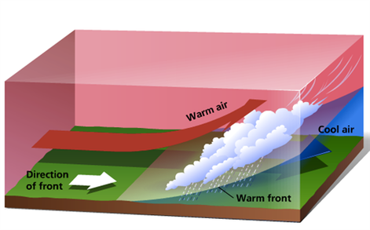
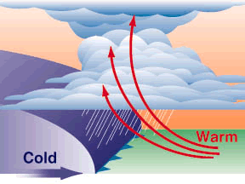
Thursday 12/1
What happens when a warm front passes through an area?
What happens when a cold front passes through an area?

Slide 5
Friday 12/2
Over track-out, I am going to…..
Don’t write “nothing”! You won’t receive credit for that ☺

