Slide 1
Monday 5/15
How do the digestive system and circulatory system work together to maintain homeostasis

Slide 2
Tuesday 5/16
How is FORCE related to MOTION?

Slide 3
Wednesday 5/17
An object that has kinetic energy must be...
A. Lifted above earth's surface.
B. In motion.
C. At rest.
D. None of the above.

Slide 4
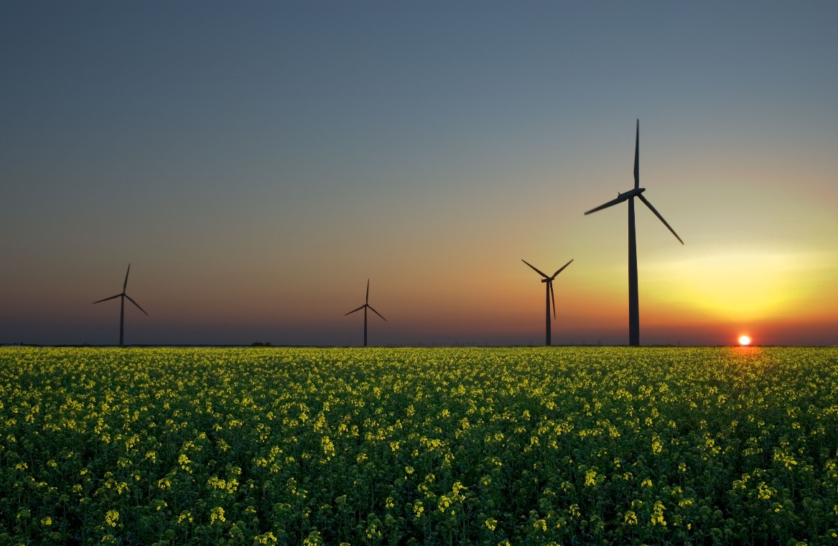
Thursday 5/18
Energy is being created and destroyed at any given moment
a. True b. False
Notes:
Inference: a conclusion you come to based off of reasoning

Slide 5
Friday 5/19
What conditions are associated with warm fronts?
Violent tornadoes and updrafts
Low temperatures and strong winds
Cloud formations and precipitation
Waterspouts and dust devils

