Slide 1
Tuesday 1/17
What type of severe weather is the most dangerous?
Thunderstorm
Hurricane
Flash flood
Tornado

Slide 2
Wednesday 1/18
What are the basic ingredients for a thunderstorm?
Cold, dry air and updrafts
Cool, dry air and downdrafts
Warm and stable humid air
Humid, unstable air and updrafts

Slide 3
Thursday 1/19
What conditions are associated with warm fronts?
Violent tornadoes and updrafts
Low temperatures and strong winds
Cloud formations and precipitation
Waterspouts and dust devils

Slide 4
Friday 1/20
Explain the difference between a cold front and a warm front

Slide 5
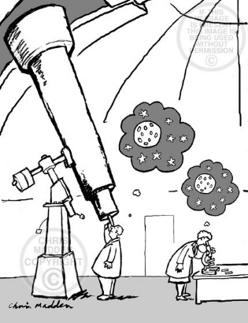
SaturdayRAAA 1/21
Explain the difference between a microscope and a telescope.

