Slide 1
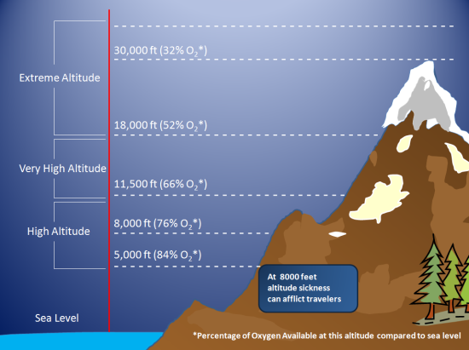
Monday 10/17
Explain what altitude is.

Slide 2
Tuesday 10/18
As altitude decreases, air pressure ______________________.
Stays the same
Decreases
Increases
Is not affected

Slide 3
Wednesday 10/19
Create a mnemonic to remember the order of the layers
Tropo— Tacos
Strato— Slathered with
Meso— Mayonnaise and
Thermo— Tamales

Slide 4
Thursday 10/20
Of the gases you took notes on yesterday, which one(s) do you think can change on a daily basis?
The gas(es) that can change on a daily basis are….

Slide 5
Friday 10/21
Free Day—Early Release

