Slide 1
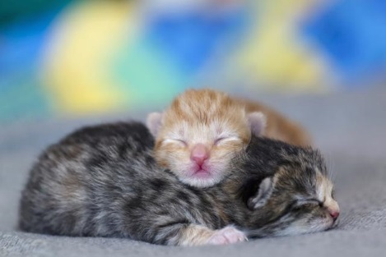
Monday 1/23
What is the basic unit of all living things?
What about nonliving?

Slide 2
Tuesday 1/24
When viewing a specimen under a microscope, always start with the _____________.
NEVER use the _______ when using the high power objective lens.

Slide 3
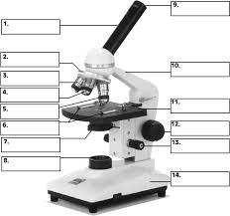
Wednesday 1/25
Label numbers 3, 4, 5, 8, 12 and 13—without looking!

Slide 4
Thursday 1/26
Explain how you calculate the power of magnification when using a microscope?

Slide 5
Friday 1/26
Essential Question: How does a cell carry out its life functions
5 ways WE carry out our life functions are:
(Example: We breathe)
1.
2.
3.
4.
5.

