Slide 1
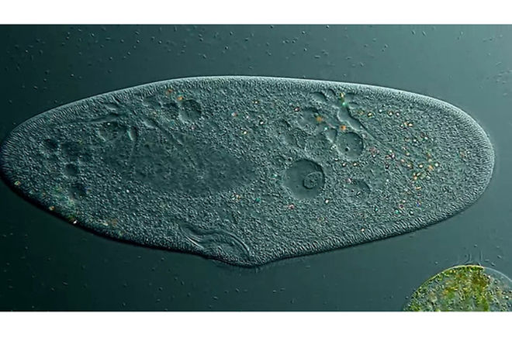
Monday 2/20
A paramecium is a type of:
Virus Plant-like protist
Ciliate
Flagellate

Slide 2
Tuesday 2/21
All protists are:
Prokaryotes Algae Bacteria Eukaryotes

Slide 3
Wednesday 2/22
Free Day—test!

Slide 4
Thursday 2/23
How do cells reproduce/divide?

Slide 5
Friday 2/24
Which answer gives the stages of mitosis in chronological order?
Anaphase, prophase, metaphase, telophase.
Metaphase, anaphase, telophase, prophase
Prophase, telophase, anaphase, metaphase
Prophase, metaphase, anaphase, telophase

