Slide 1
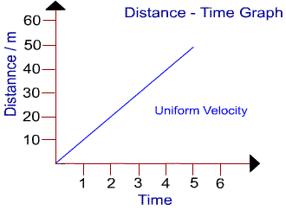
Monday 8/08
What does this type of slope mean on a Distance-Time Graph?
DRAW THE GRAPH!
Notes:
Inference: a conclusion you come to based off of reasoning

Slide 2
Tuesday 8/09
The THREE indicators of acceleration are:
_______________________
_______________________
_______________________
Notes:
Inference: a conclusion you come to based off of reasoning

Slide 3
Wednesday 8/10
Adam rode his bike to a friends house at 4m/s W. As he neared the house, his velocity was 2m/s W. Adam’s trip showed:
a. Negative acceleration b. Positive acceleration c. Zero acceleration d. A steady speed
Notes:
Inference: a conclusion you come to based off of reasoning

Slide 4
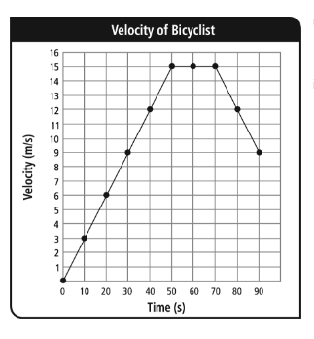
Thursday 8/11
Describe the velocity of the biker from 70s to 90s
Notes:
Inference: a conclusion you come to based off of reasoning

Slide 5
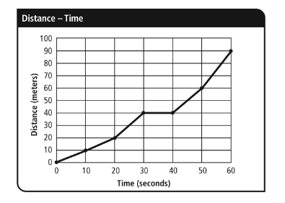
Friday 8/12
What is the average speed for the first 30 seconds of the trip?
Draw the graph for this one ☺
Notes:
Inference: a conclusion you come to based off of reasoning

